Slide 1
Functions

Slide 2
Functions
A function is a group of statements that exist within a program for the purpose of performing a specific task.
A function is a reusable portion of a program
We can break the programme’s code into sections called functions.
This makes it easier to develop and debug a programme as it grows.
It can be called from many locations.
The statements are named by defining a function. The statements are executed by calling a function.

Slide 3
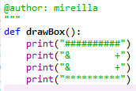

Defining & Calling Your Functions
A function begins with a line that consists of def, followed by the name of the function that is being defined, followed by an open parenthesis, a close parenthesis and a colon.
That line is followed by the body of the function, which is a collection of statements that will execute when the function is called.
A function is a set of statements that take inputs, do some specific computation and produces output.
A function is called by its name followed by parentheses.
Calling the function created by the user
output

Slide 4


Calling Pre-defined Functions
Many programmes perform many tasks. Some examples: reading input values from the keyboard, sorting a list, and computing the square root of a number, etc.
Python provides functions that perform these common tasks. These functions have been defined by the people that created Python.
The programme that we create will call these functions so we don’t have to solve these tasks ourselves.
Many functions require values when they are called such as a list of name to sort or the number for which the Square root will be computed. These values are known as arguments and are placed inside the parentheses when the function is called.
A function call can have many arguments separated by a comma.
Example: This assignment statement calls the round
function,
which rounds a number to the nearest integer. When it is run, the output is:

Slide 5
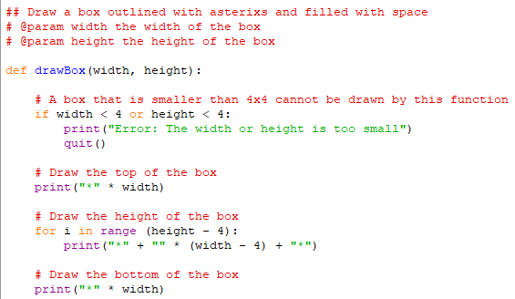
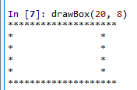
Functions with Parameters
Our basic example of function, drawBox works correctly but it is not flexible, so not very useful.
For it to be useful and flexible, we want our function to draw boxes of many different sizes.
Our function will take arguments (see previous slide). It will receive these argument values in parameter variables that are included inside the parentheses when the function is defined.
In our example we will add two parameters to the definition of drawBox which contains the width and height of the box.

Slide 6
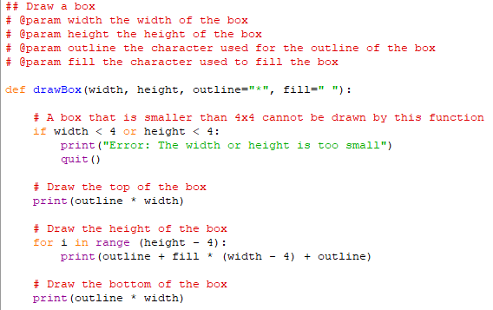
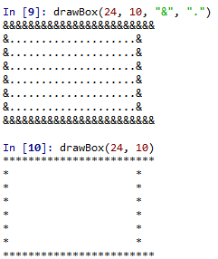
Functions with Parameters
Now we want to update our function to enable the user to change the outline (previously asterix) with a different character and fill it with different characters. We add two additional parameters: outline and fill
Output when the function call includes all 4 arguments
Output when the function call includes the first 2 arguments. The default ones asterisk and empty space are used for 3rd and 4th argument

Slide 7
Variables in Functions
Local variable: a variable is created inside a function. Only exists when the function is executing and can only be accessed within the body of that function. Cannot be access when the function returns.
Variables created with assignment statements in the body of a function are also local variables.
The drawBox function uses several variables.
Parameter variable such as width and fill that are created when the function is called
The for loop control variable, i, that is created when the loops begins to execute.

Slide 8
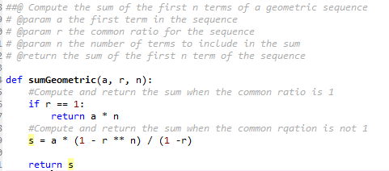

Return Values
Our drawBox function only outputs characters on the screen.
Many functions can take an argument, compute a value that is stored in a variable and used later in the programme.
For example the input function reads value typed by the user and then returns it so that it can be used later in the programme. Similarly, the sqrt function in the math module computes the square root of its argument and returns this value that will be used in other calculation
A function returns a value using a return function
The returned s

Slide 9
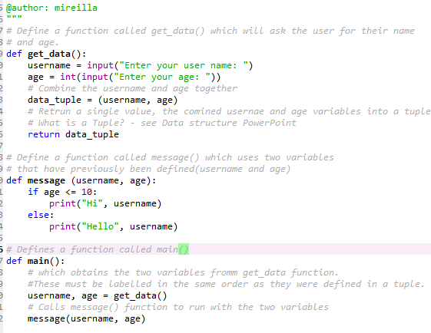
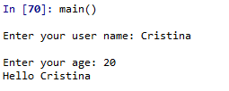
Function code example

Slide 10
Input and Output Functions
Read input
Python reads input from keyboard by calling the input() function.
a = input(): A value type by the user will be stored in the variable called a.
The input function always returns a string
Display output
print() function. Can be called with one argument.
Can print multiple values.
Arguments to a function call can be values and variables.

Slide 11



Importing Functions into Other Programmes
Import function
Functions like input and print are used in many programmes and are available in those programmes. The less commonly used function are stored in libraries/modules and need to be imported when needed.
For example, additional mathematical functions are stored in the math module. Functions in math module include sqrt, ceil and sin.
A function imported from a module is called by using the module name, followed by a period, followed by the name of the function and its arguments.
A function call from different locations is easy when the function definition and call locations are in the same file.
If you want to call a function that you wrote for a previous programme while solving a new problem, use the import keyword, followed by the name of the Python file that contains the function you want (without .py extension). This calls all those functions but also run those programme.
If we only want to call those functions without running the programme, create a function called main that will contains the statements needed to solve the problems. Add this line of code to ensure that the main function does not execute when the file has been imported into another programme.

Slide 12
Maths with Python
As mentioned in the previous slide, Python can perform several mathematical functions. Data is either integer (a whole number) or floating-point number (number with a decimal place). In order to use some of the mathematical functions (e.g. math.sqrt.(num1) and math.pi), you will need to import the maths library.
print(round(num, 2)) displays the number rounded to two decimals
** means to the power of (e.g. 10² is 10**2).
math.sqrt(number1): The square root of a number
number1 = float(input(“Enter number: “)) Allows numbers with a decimal point dividing the integer and fraction part.
math.pi gives the pi to 15 decimal places
x // y: Whole number division (e.g. 15//2 gives the answer 7
x % y: Finds the remainder (e.g. 15%2 gives the answer 1)

Slide 13
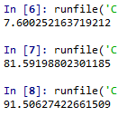


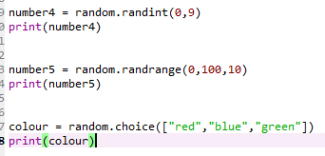
Random
number1 = random.random will select a random floating-point number between 0 and 1 and stores it in a variable called number1. It is multiplied by 100 to get a larger number
You can generate random values in Python using random library.
These random values can be:
Random numbers within a specified range.
A random choice from a range of items that are input.
Creates a random floating-point number by creating two random integers within two large range and dividing one by another
Number4: Selects a random whole number between 0 and 9 (inclusive)
Pick a random number between 0 and 100 (inclusive) in steps of ten i.e. 0,10,20,
Picks a random value from the options “red”, “blue” and “green” and stores it as the variable “colour”

Slide 14
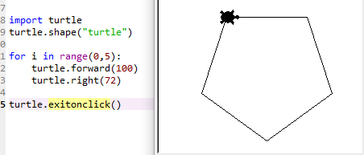
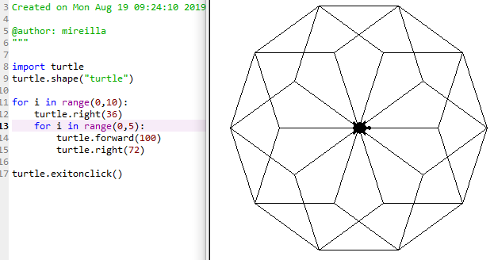
Turtle Graphics
You can draw intricate shapes using turtle in Python using programmes that repeat simple moves such as loops.
As seen in the example, a pentagon is drawn using the code next to it.
Using nested loops (a loop inside a loop) a beautiful pattern is created.

